Slide 1

Microsoft Azure AI What is The Latest & Future Roadmap
Agenda Azure AI Introduction
What is New?
Demos – o1, Local Models, Realtime Speech
Where to find New Innovations
Azure AI Roadmap Considerations
Bart Czernicki
Principal Global Black Belt | Artificial Intelligence
Email: bczernicki@microsoft.com
LinkedIn: https://www.linkedin.com/in/bartczernicki/
Twitter (X): https://twitter.com/bartczernicki
GitHub: https://github.com/bartczernicki
Version: December 2024

Slide 2










Microsoft Azure AI
Where innovators are creating the future
Azure OpenAI Service
Azure AI Vision
Azure AI Search
Azure AI Speech
Azure AI Document Intelligence
Azure AI Translate
Azure AI Content Safety
Azure AI Language
Azure Machine Learning

Slide 3







Announcing
Azure AI Foundry
Model Catalog
Copilot Studio
Foundational models
Open-source models
Task models
Industry models
Visual Studio
Azure OpenAI Service
Azure AI Search
Azure AI Agent Service
Azure AI Content Safety
GitHub
Evaluations
Customization
Governance
Monitoring
Azure AI Foundry SDK
Observability

Slide 4
Azure AI Studio – Generally Available
Public preview
Azure AI Foundry SDK
Unified toolchain for AI application development
Access our leading models through a single interface
Easily integrate Azure AI capabilities into your applications
Develop faster with a simplified coding experience
AI.Azure.com

Slide 5



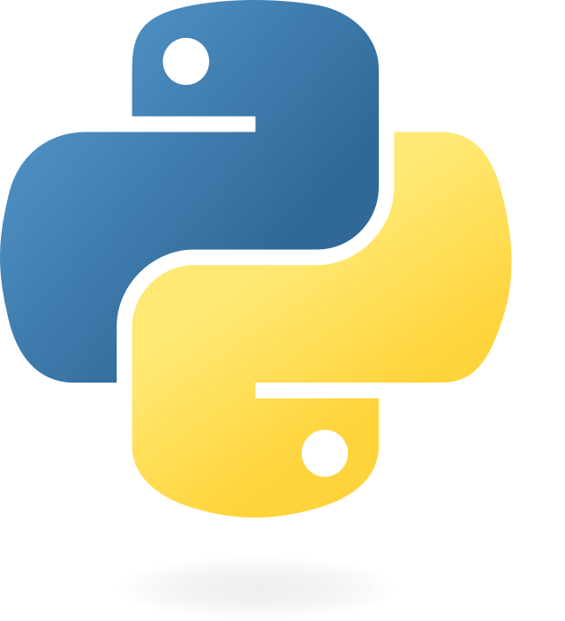
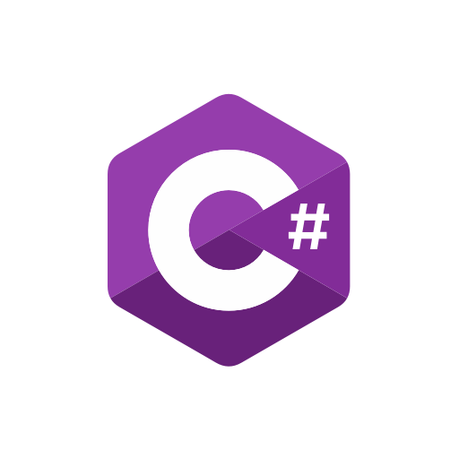

Azure AI Studio – Generally Available
1
2
Single-agent
Multi-agent
Deploy agents with Azure AI Foundry
Orchestrate them together with AutoGen and Semantic Kernel
Managed agent micro-services
State-of-the-art research SDK
Production-ready and stable SDK
Ideation
Production

Slide 6





Azure AI Studio – Generally Available
Introducing
Azure AI Agent Service
Built-in enterprise readiness
Extensive ecosystem of tools
Microsoft Fabric
BYO-model
BYO-file storage
BYO-search index
BYO-thread storage
BYO-virtual network
Limitless scaling
OBO authorization support
Enhanced observability
Llama stack integration
SharePoint
+
+
Grounding with Bing Search
Assistants API
Grounding with licensed data
File Search with Azure Blob Storage
Azure Logic Apps
OpenAPI 3.0 Specified Tools
Azure Functions

Slide 7

Azure AI model breadth
Offering a wide collection (1,700+) of frontier and open models
Azure OpenAI Service
Phi models
Meta
Mistral AI
Cohere
GPT-4o
Phi-3-mini
Llama-2-70b/70b-chat
Mistral Large
Cohere R+
GPT-4-Turbo with Vision, GPT-4, GPT-3.5
Phi-3-small
Llama-2-13b/13b-chat
Mistral 7B
Cohere R
Embeddings
Phi-3-medium
Llama-2-7b/7b-chat
Mixtral 8x7B – Mixture of Experts
Embed v3-Multilingual
DALL·E
Phi-3-vision
Llama-3
Embed v3-English
Whisper, Text to speech
CodeLlama
Hugging Face
Databricks
NVIDIA
Snowflake
Falcon/TII
Databricks/dbrx-base
Nemotron-3-8B-4k
Snowflake/arctic-base
Stable Diffusion/Stability AI
Databricks/dbrx-instruct
Nemotron-3-8B-Chat-SFT/RLHF/ SteerLM
Snowflake/arctic-instruct
Dolly/Databricks
Nemotron-3-8B-QA
CLIP/OpenAI

Slide 8
What is New?
Update on the Latest Announcements

Slide 9
Azure AI Updates
Latest Updates as of November 2024
1
Azure AI Foundry
Single experience and SDK to develop AI Solutions
6
OpenAI o1 Series Models
Unlock Deeper Reasoning & Decision Intelligence
2
Microsoft Copilot Integrations
Extend in or out into with Copilot + Azure
7
OpenAI GPT-4o-mini-Model
Leading GenAI Cost & Performance balance
3
Microsoft Enterprise AI Agent Service
Scale AI Agents with Enterprise Features
8
Microsoft Phi 3.5 Refresh & Microsoft OSS
Microsoft Open Source that are Commercial Ready
4
New Global Provisioned & Azure Data Zones
Optimize AI Traffic Orchestration & Deployment
9
OpenAI GPT-4o-2024-08-06 Model
100% Adherence to JSON Output
5
Self-Service Provisioning
Managed AI Deployments in Portal or with APIs
10
OpenAI Real Time API (Audio)
Native Speech-To-Speech Paradigm at Scale

Slide 10




Generative AI Scaling Optimizations
Accuracy
Latency
Cost
Generative AI Model Selection (*)
Generative AI Model & Provider Selection (*)
Prompt Optimization
Model Deployment Types (*)
Model (API) Parameters
Minimize Input (Prompt) Tokens
Shorter Model Context Windows
Minimize Output Tokens
RAG (*)
Prompt Caching (OpenAI API)
Azure AI Groundedness (*)
Transformer KV Caching (OpenAI)
GenAI Lifecycle Management (*)
Evaluation Driven Dev (*)
Prompt To Completion Ratio
GenAI Partner Management (*)
OpenAI Logprobs
Authoritative GenAI Responses (*)
GenAI Platform Strategy (*)
Model Fine-Tuning (*)
Model Request Orchestration (*)
* Identified items available for additional and advanced optimizations on the Microsoft AI platform services

Slide 11



2025 Your Top Three AI Imperatives
Advanced AI Reasoning
Enterprise AI Agents
Talk to AI
Generative AI Large Reasoning Models support important decision, risk analysis and complex business problems
AI Agents enter the workforce
New simplified AI user experience to unlock full potential of Generative AI

Slide 12

Risk Analysis with o1 Series
Unlock advanced Logic and Reasoning
https://github.com/bartczernicki/RiskAnalysisWithOpenAIReasoning

Slide 13
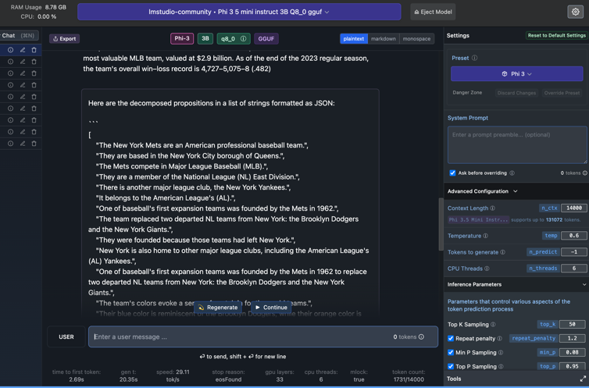
Run AI Models on Non-Cloud Hardware
LM Studio Running Phi 3.5 on MacOS
https://lmstudio.ai/

Slide 14

Speech To Speech Demo
Realtime Audio API
https://www.youtube.com/watch?v=vXJka8xZ9Ko
https://github.com/Azure-Samples/aisearch-openai-rag-audio
https://github.com/Azure-Samples/aoai-realtime-audio-sdk
Unleashed with Azure Communication Services
https://techcommunity.microsoft.com/blog/azurecommunicationservicesblog/ignite-2024-bidirectional-real-time-audio-streaming-with-azure-communication-ser/4304588
https://learn.microsoft.com/en-us/azure/communication-services/concepts/call-automation/audio-streaming-concept

Slide 15
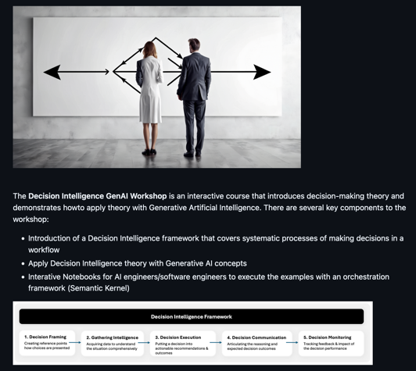
Decision Intelligence Workshop
Digitize Decision-Making with AI
https://github.com/bartczernicki/DecisionIntelligence.GenAI.Workshop

Slide 16
Find Azure AI Updates Like a Pro
Where can I ”keep up” with the Latest on Azure AI?
Azure AI Studio (Continuous Updates, Private Previews, Fast-Follow Launch with OpenAI)
https://ai.azure.com
What is New in Azure OpenAI Service (Continuous Updates of what is new the Azure OpenAI Service)
https://learn.microsoft.com/en-us/azure/ai-services/openai/whats-new
Azure AI Services Blogs (New Updates from AI Engineering & AI Technical Field)
https://techcommunity.microsoft.com/t5/ai-azure-ai-services-blog/bg-p/Azure-AI-Services-blog
Azure OpenAI Service Model Deprecations & Retirements
https://learn.microsoft.com/en-us/azure/ai-services/openai/concepts/model-retirements
Well Architected Framework (WAF) 2.0 (Best Practices on Implementing AI Solutions)
https://learn.microsoft.com/en-us/azure/well-architected/whats-new
Azure AI Samples on GitHub (Collection of Repositories with new AI Capabilities)
https://github.com/Azure-Samples/azureai-samples

Slide 17



Special Relationship with OpenAI
Ensure that artificial general intelligence (AGI) benefits humanity
Empower every person and organization on the planet to achieve more
Azure OpenAI Service
Started as an AI research company and now market leading GenAI services provider
Largest Software Company in the world and one of the largest cloud hyper scalars + AI
What does this translate to?
All the power of AI (including OpenAI), software and cloud services under from a single provider

Slide 18
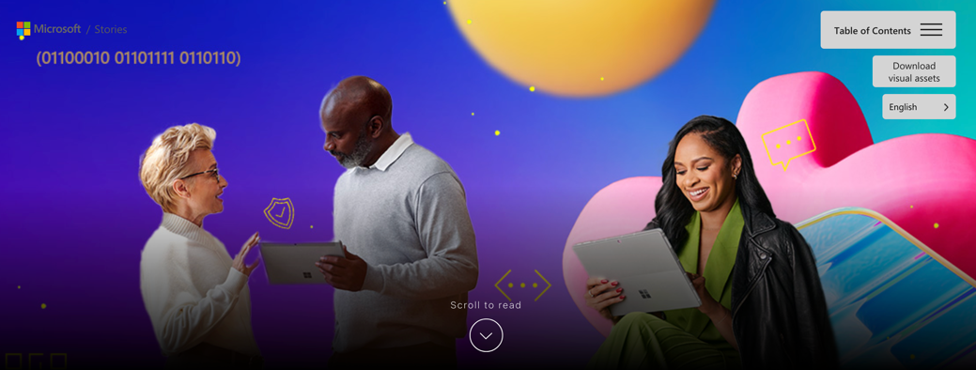
Ignite 2024 Book of News
Current from November 2024 - February 2025
https://news.microsoft.com/ignite-2024-book-of-news/

Slide 19
Azure AI - Fast Follow Roadmap
Same Day in Azure AI Studio Playground or ~2 Weeks for API
Examples of OpenAI Releases that Are or Potentially Fast Following to Azure
Introducing the Realtime API (ChatGPT Advanced Mode)
https://learn.microsoft.com/en-us/azure/ai-services/openai/how-to/audio-real-time
Vision Fine-Tuning API
https://openai.com/index/introducing-vision-to-the-fine-tuning-api/
Prompt Caching in the API
https://openai.com/index/api-prompt-caching/
API Model Distillation
https://openai.com/index/api-model-distillation/
ChatGPT Canvas (New way to write code)
https://openai.com/index/introducing-canvas/
Scaling AI Applications Best Practices
https://github.com/bartczernicki/ArtificialIntelligence-Presentations/tree/master/GenAI/ScalingGenerativeAI

